Slide 1






RXJS & NGRX
Reactive Extensions Library for JavaScript & Angular Reactive Extensions (Redux)
By : Mahmoud Abdelaziz and Omar Walid

Slide 2
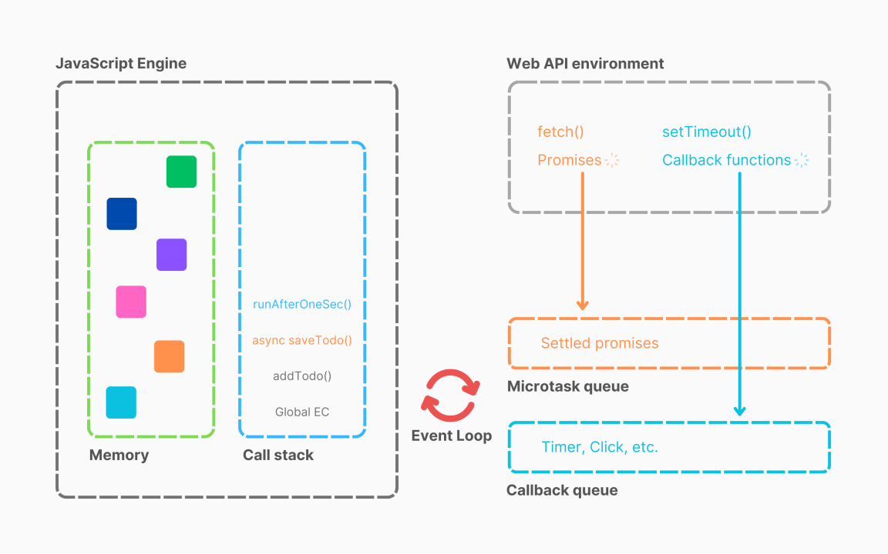
Synchronous vs Asynchronous
1

Slide 3
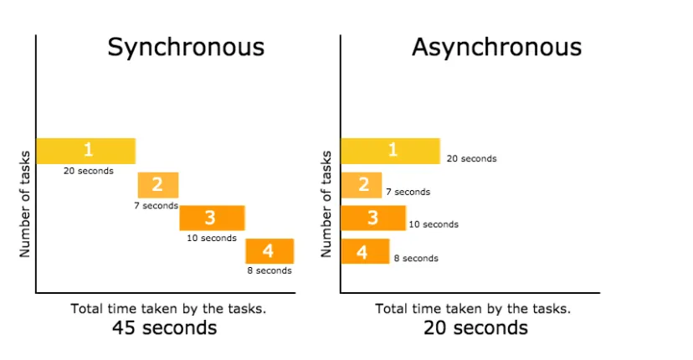
Synchronous vs Asynchronous
2

Slide 4
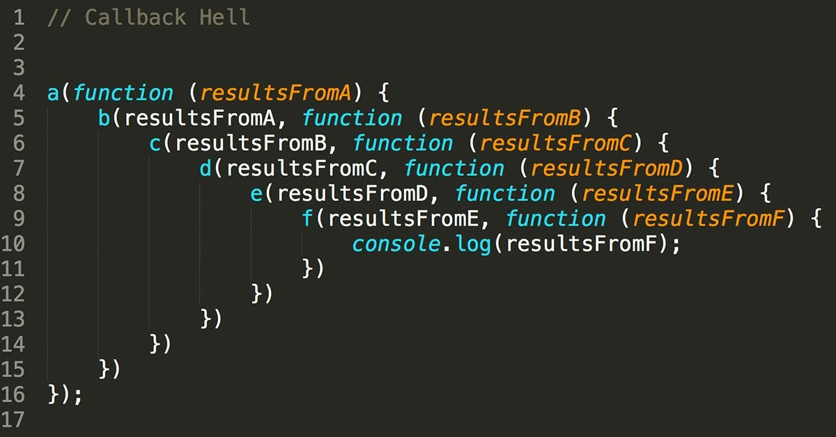

Introduction
Callback Hell:

Slide 5

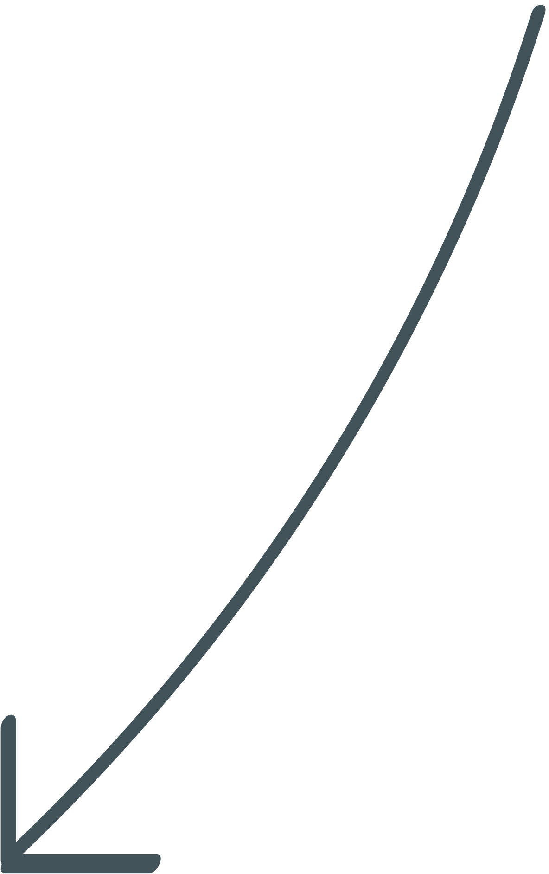

Introduction
Coding
Callback
Promise

Slide 6
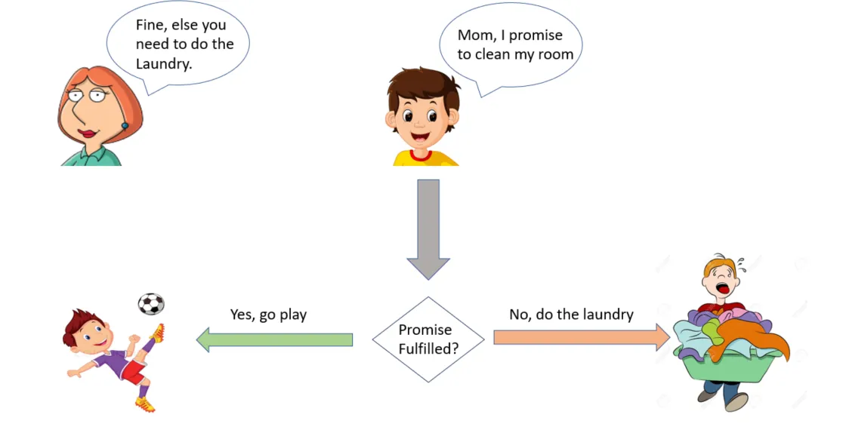

Introduction
Promises:

Slide 7
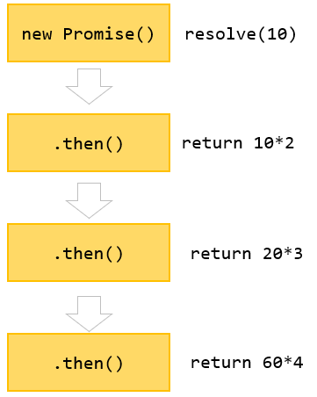
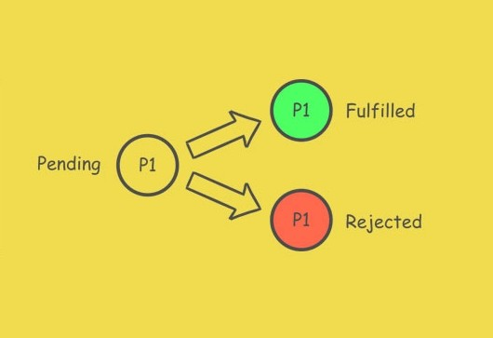

Introduction
Promises:

Slide 8

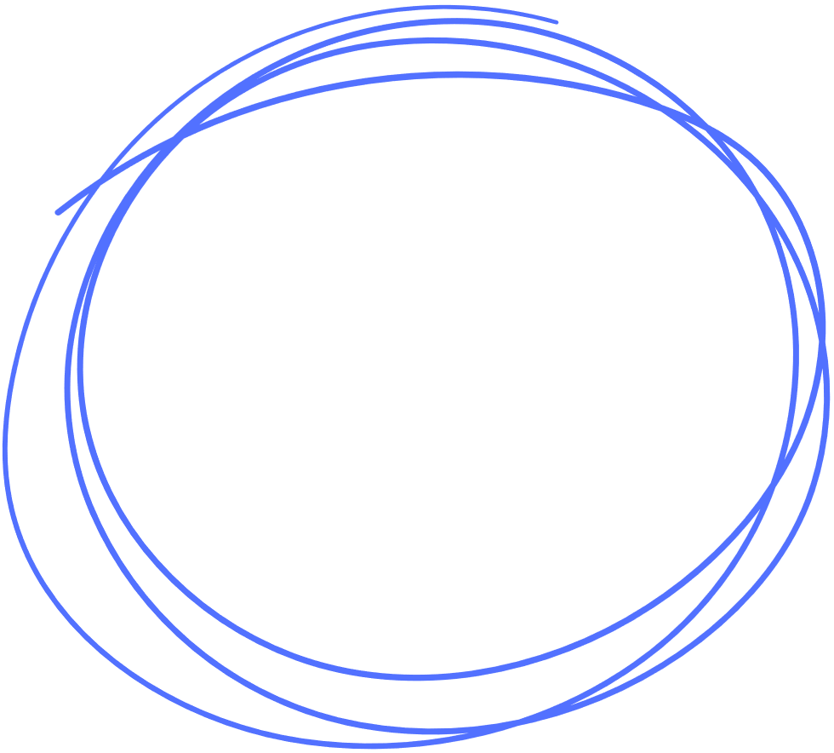

Introduction
Coding
Callback
Promise
RXJS

Slide 9


1
RXJS [Reactive Extensions Library for JavaScript ]
2
3
RXJS is a library for Composing Asynchronous and event-based programs by using Observable sequences.
4
?
?
?
Stream
vs
Reactive Stream
Pull vs Push Systems
Sync vs Async

Slide 10


Push vs Pull Systems
Pull |  | Push
Consumers pull (request) data from a producer. Consumer controls when data is requested. |  | Data is pushed to consumers asynchronously. Producer controls when data is sent.
Single | Multi | Single | Multi
Regular Fun | Fun Generator | Promise | Observable

Slide 11
Stream vs Reactive Stream
Stream | Reactive Stream
Collection Of Data [Size Predetermined] | Event [Size Unknown]
Iterable | Observable
Timers
Event-Based
Observable
10

Slide 12
Composing
A
B
C
X
g(x)
f(g(x))
f
g
g(f(x))
x
f(x)
gof
11

Slide 13
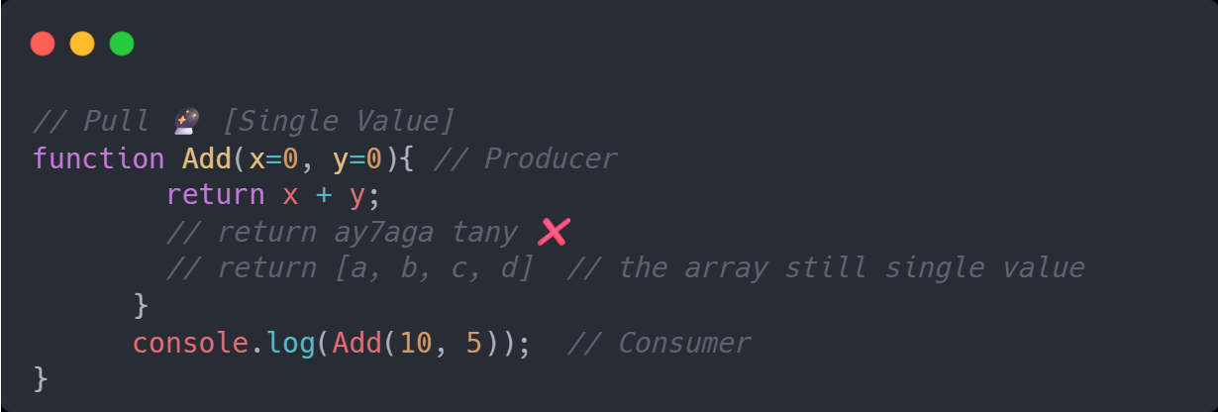
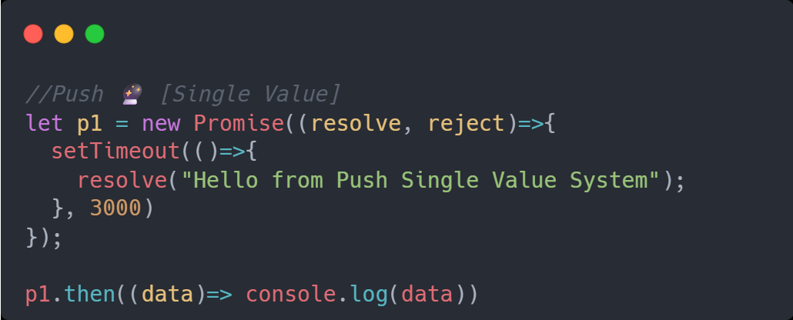
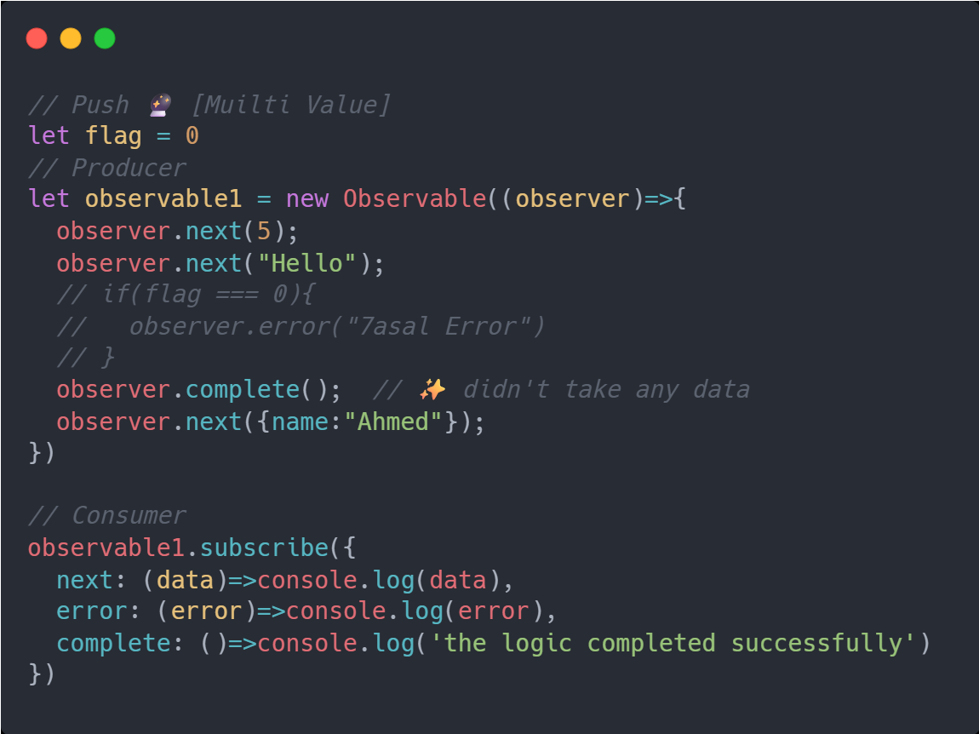
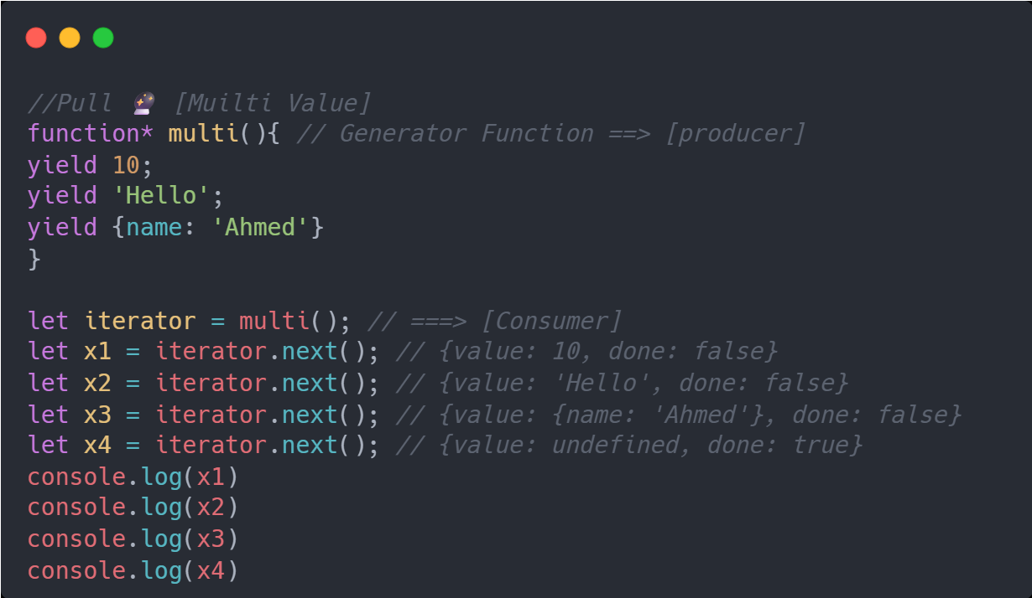
Pull vs Push Sys
Pull
[single Value]
Push
[single Value]
Pull
[Multi Value]
Push
[Multi Value]
12

Slide 14
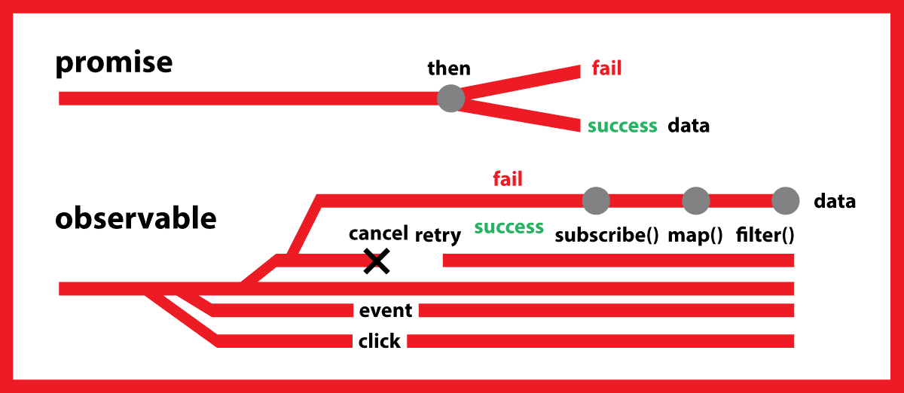
Observables vs Promises
Promises | Observables
Single Value | Multiple Value
Not Lazy | Lazy
Not Cancelable | Cancelable
Not Completion Callback | Completion Callback
13

Slide 15
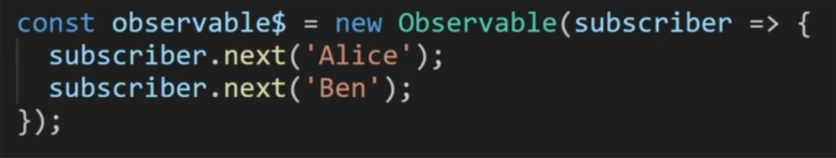
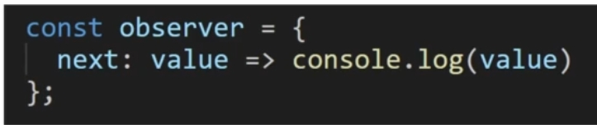

Observables
Observable
Observer
Subscription
14

Slide 16
Observables
Subscribe1
Observable
Sub1
Still getting Data
from Observable
Subscribe2
if
Observable
Observable
Sub2.unsubscribe();
Means Sub2
Stop getting Data From Observable
Subscribe3
Observable
Sub3
Still getting Data
from Observable
15

Slide 17
Observables
Subscribe1
Observable
Sub1
Stop getting Data
from Observable
if
Subscribe2
observer. complete();
Means Observable
Itself will not send any data to
All Subscribers
Observable
Observable
Sub2
Stop getting Data
from Observable
Subscribe3
Observable
Sub3
Stop getting Data
from Observable
16

Slide 18
Observables
A
B
C
Compelete
A
B
C
Erorr
A
B
C
17

Slide 19
Observables
A
B
C
D
E
A
B
C
D
E
A
B
C
A
B
C
18

Slide 20
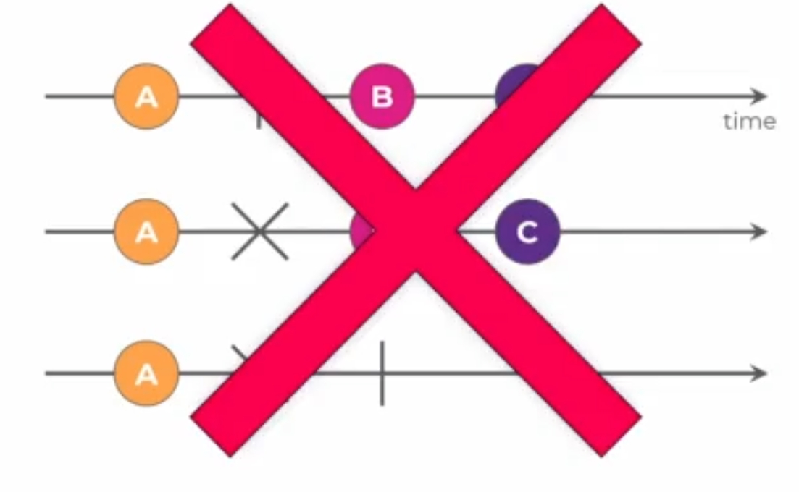
Observables
ALL ARE INVALID SENARIOS
19

Slide 21
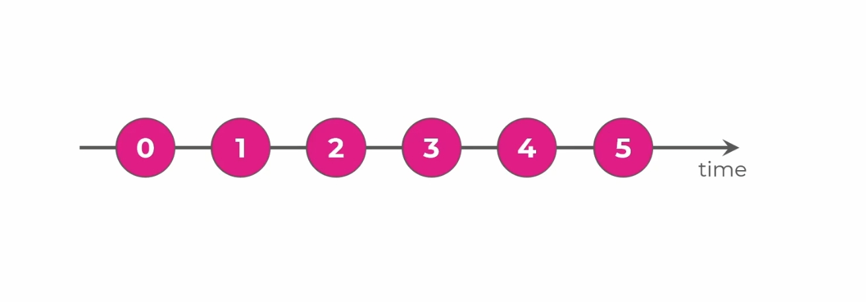
Observables
20

Slide 22
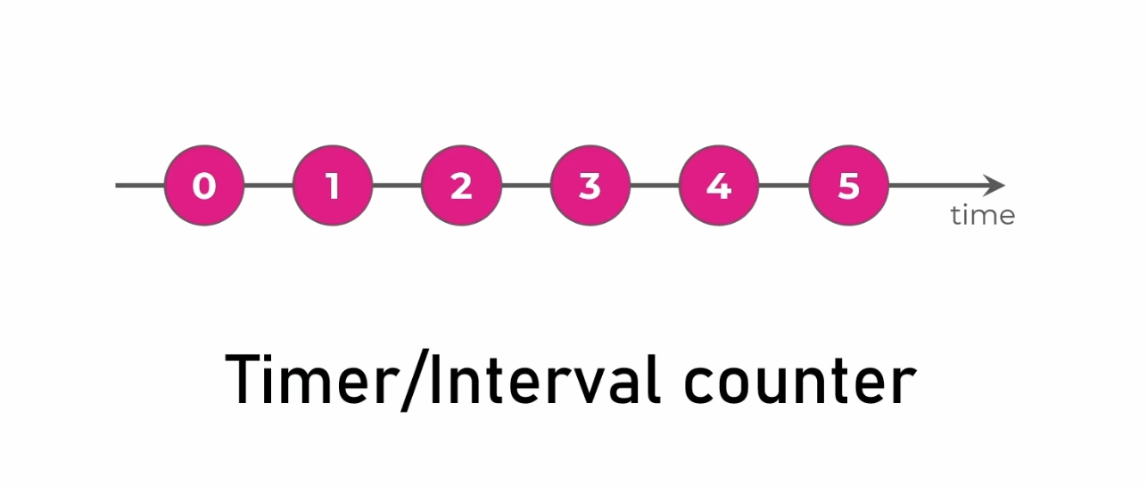
Observables
21

Slide 23
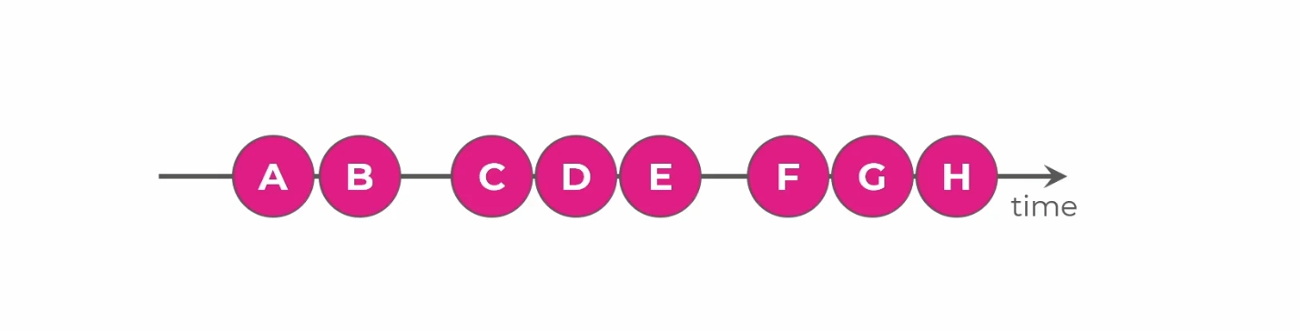
Observables
22

Slide 24
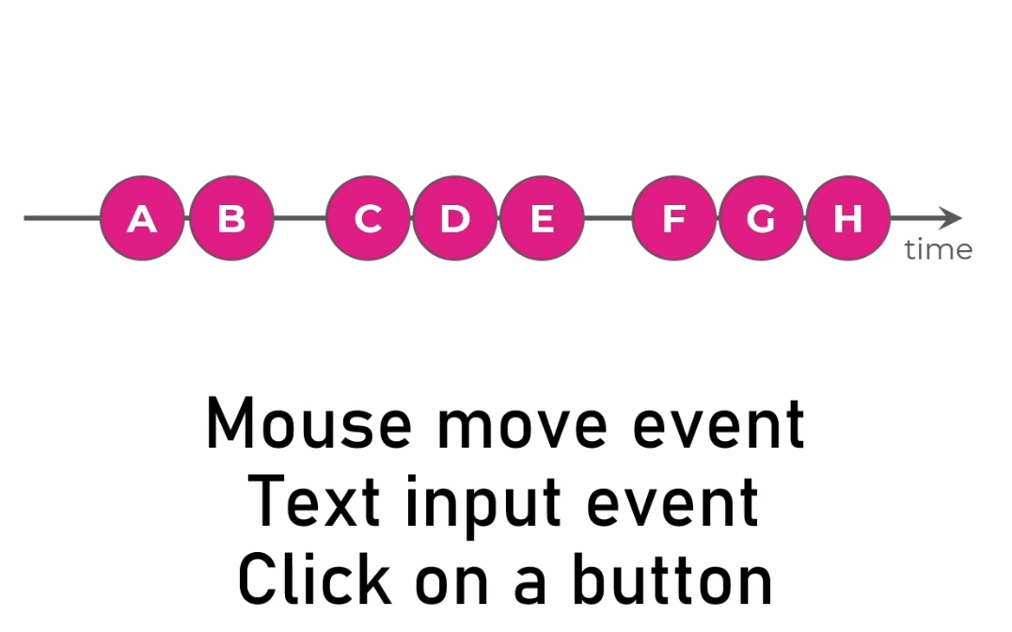
Observables
23

Slide 25
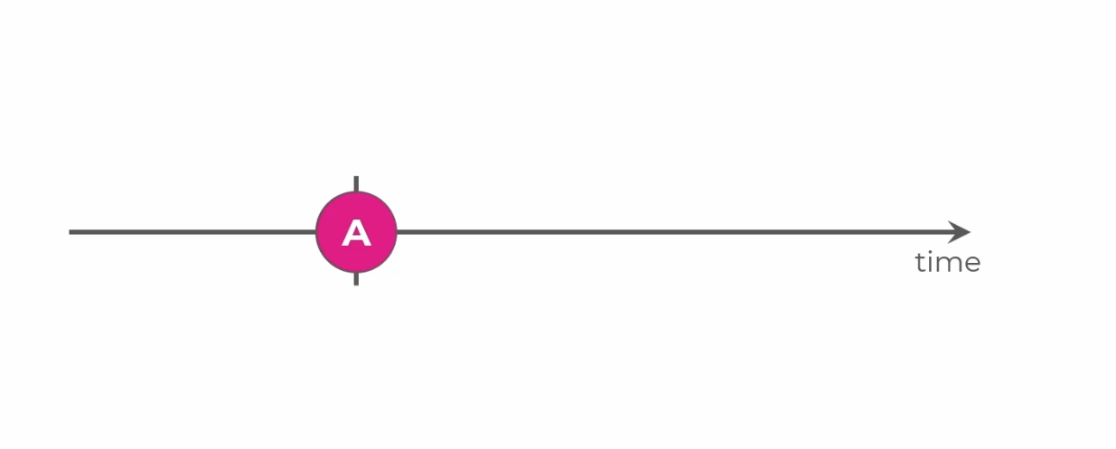
Observables
24

Slide 26
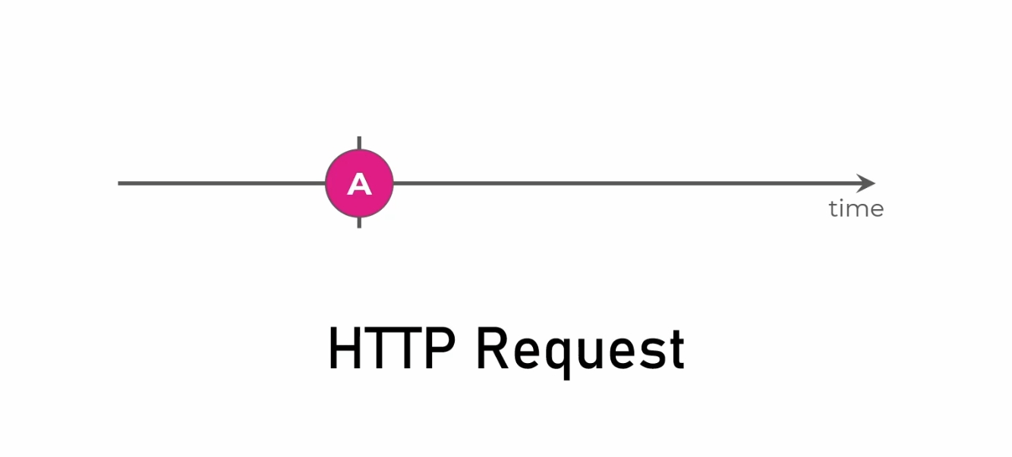
Observables
25

Slide 27
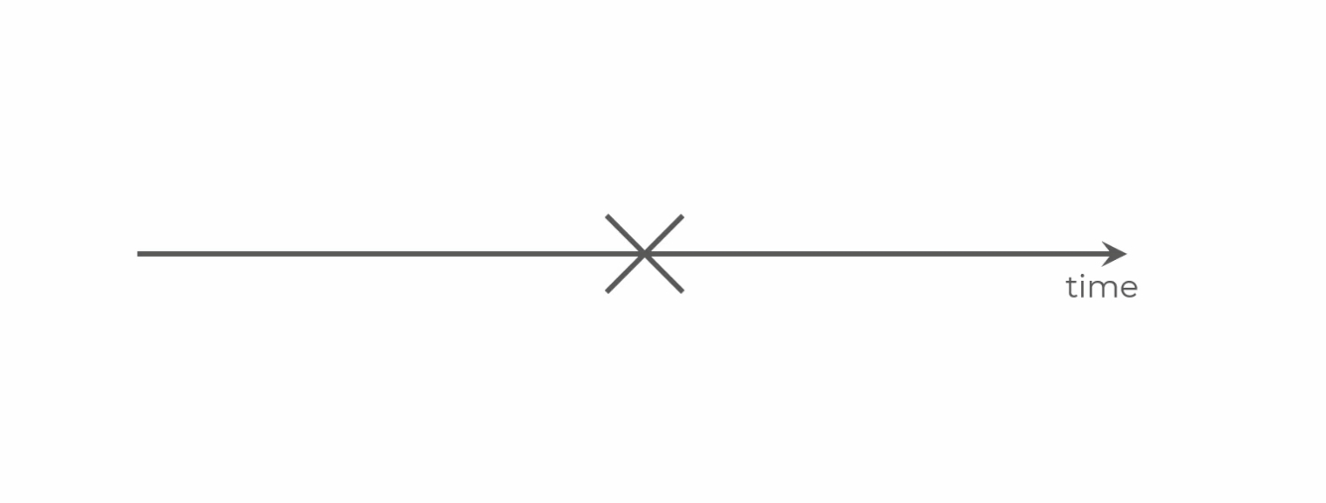
Observables
26

Slide 28
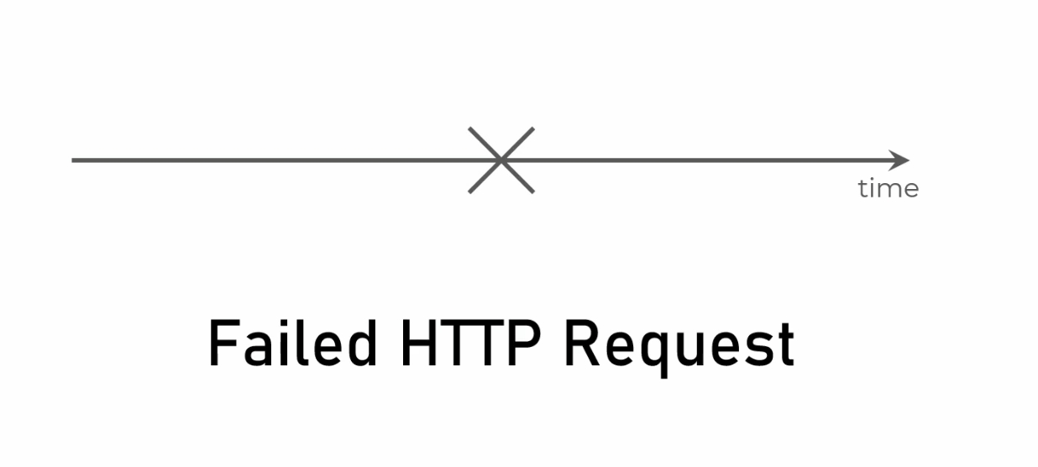
Observables
27

Slide 29
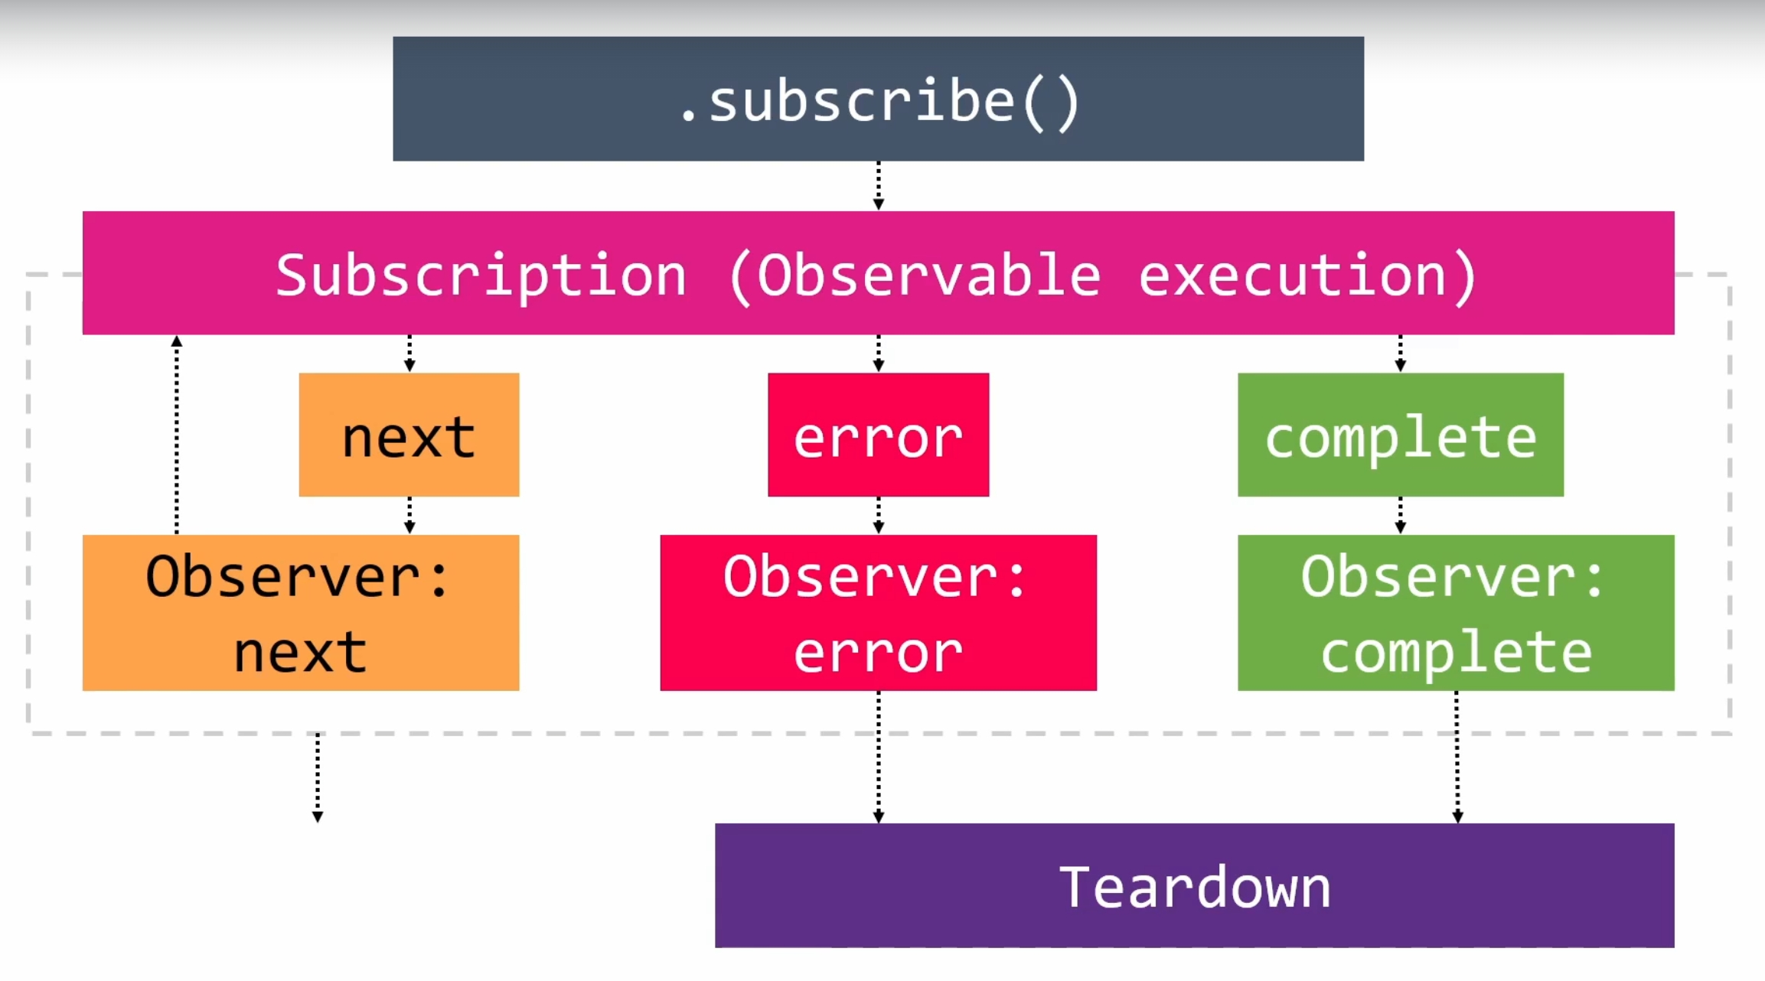
Observables
28

Slide 30
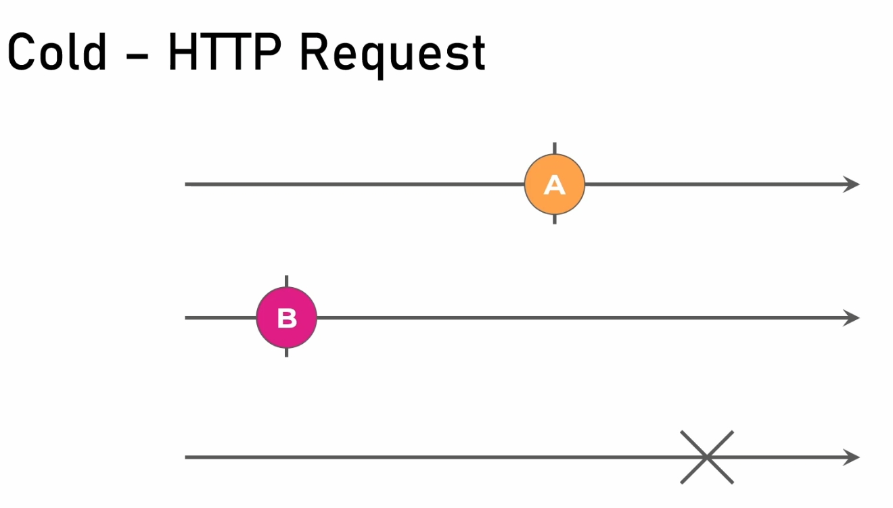
Creational Operators
18

Slide 31
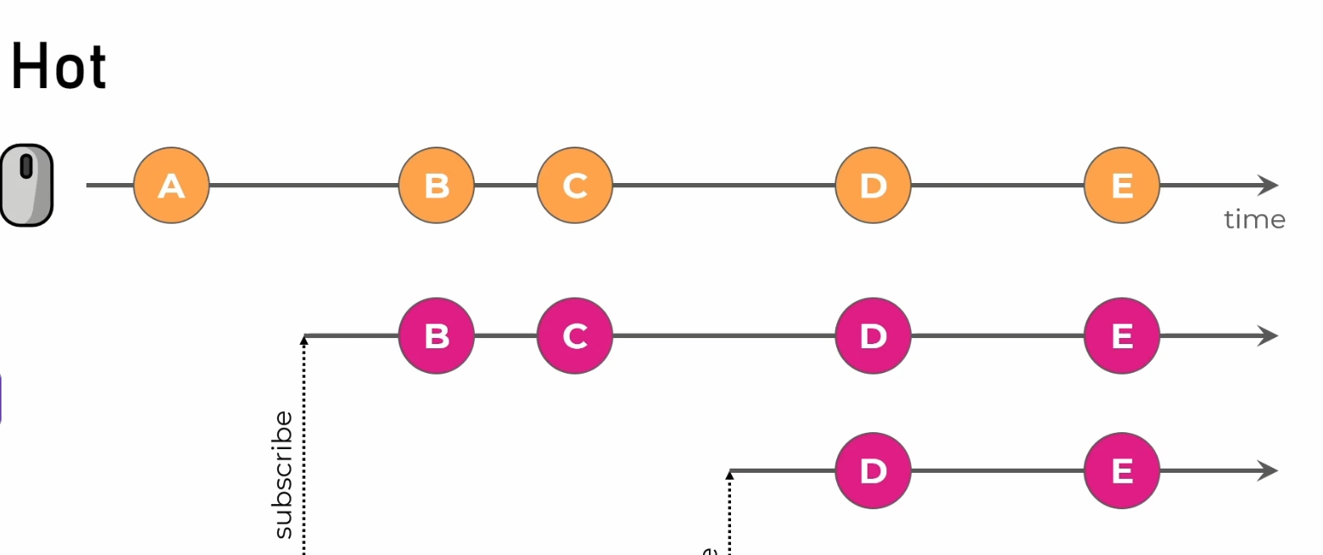
Creational Operators
18

Slide 32
Operators
Operators
Pipe
Creational Operators
Pipeable Operators
☝️
first and then
👇
EX 👉
Interval
Of
From
Timer
Range
Map
Filter
First
Take
TakeUntil
👈 EX
17

Slide 33
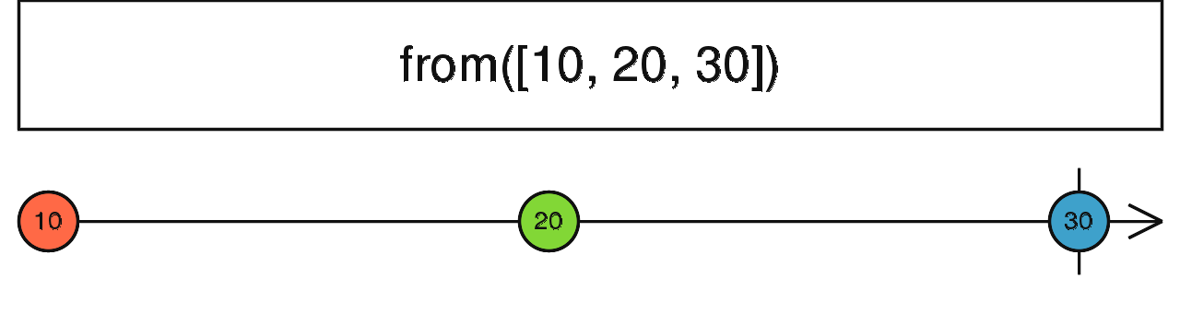
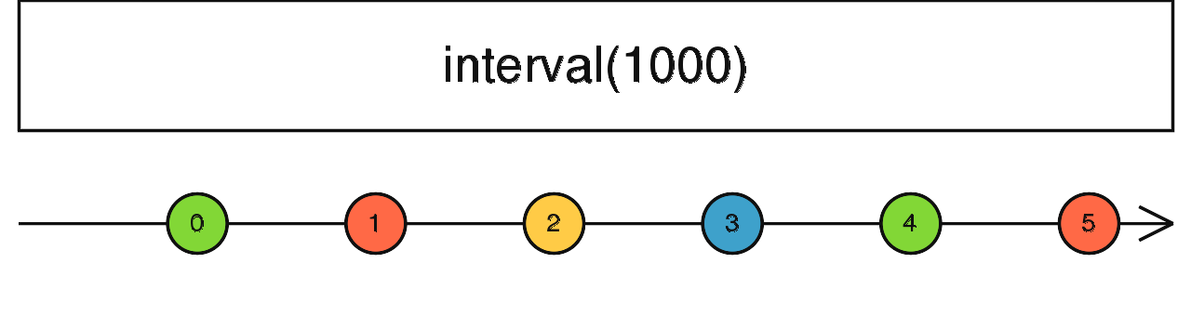
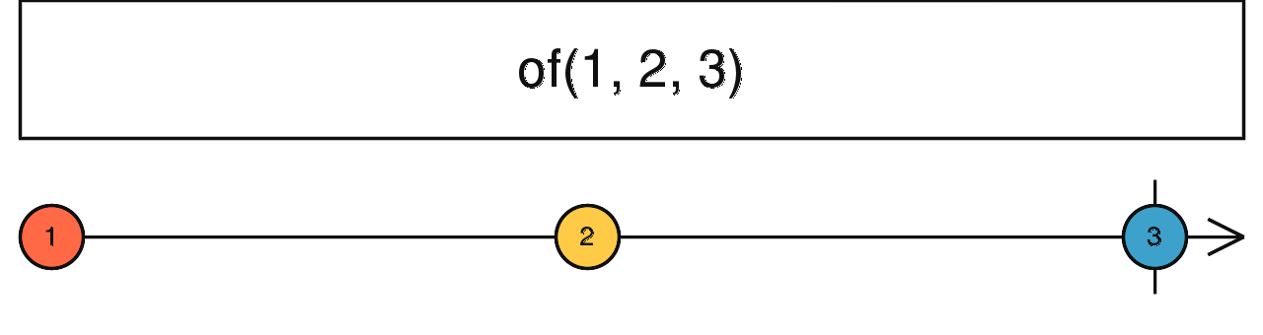
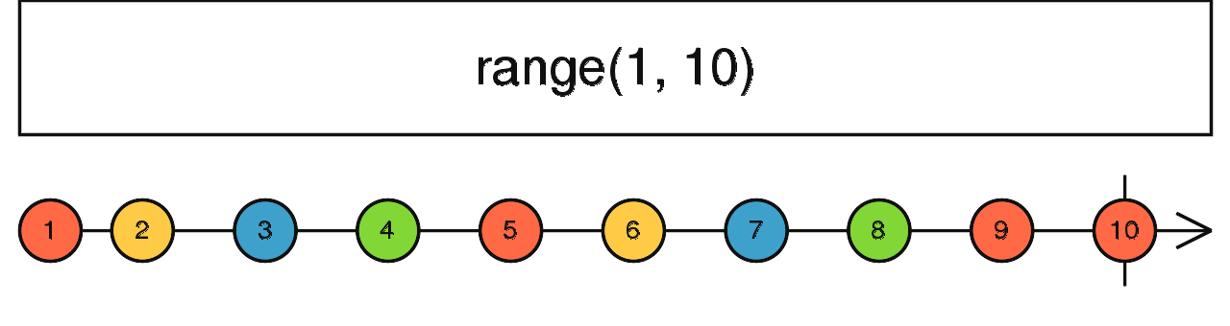
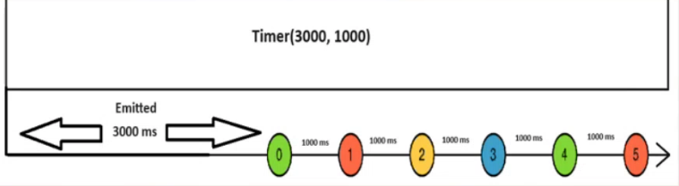
Creational Operators
18

Slide 34
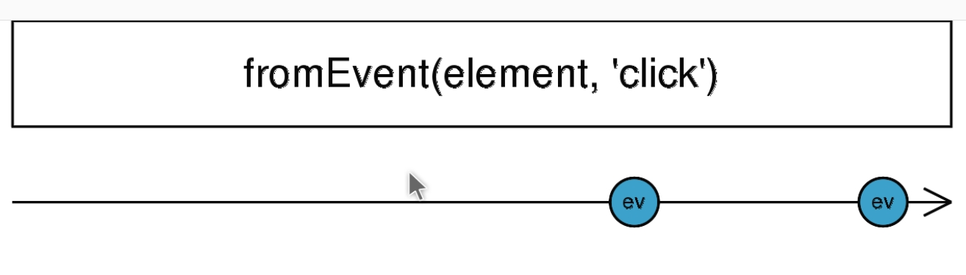
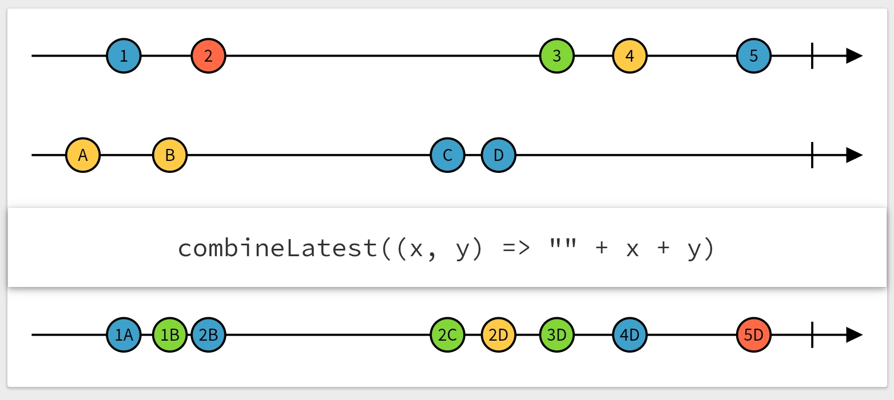
Creational Operators
18

Slide 35
Event Observable
JavaScript
RXJS
Return Observable
document.getElementsByTagName(“body”)[0]
.addEventListener(‘click’,
() => {“You Clicked Now”})
Import {fromEvent} from ‘rxjs’;
Let evt$ = fromEvent(document, ‘click’);
evt$.subscribe({
next: () => {“You Clicked Now”}
})
25

Slide 36
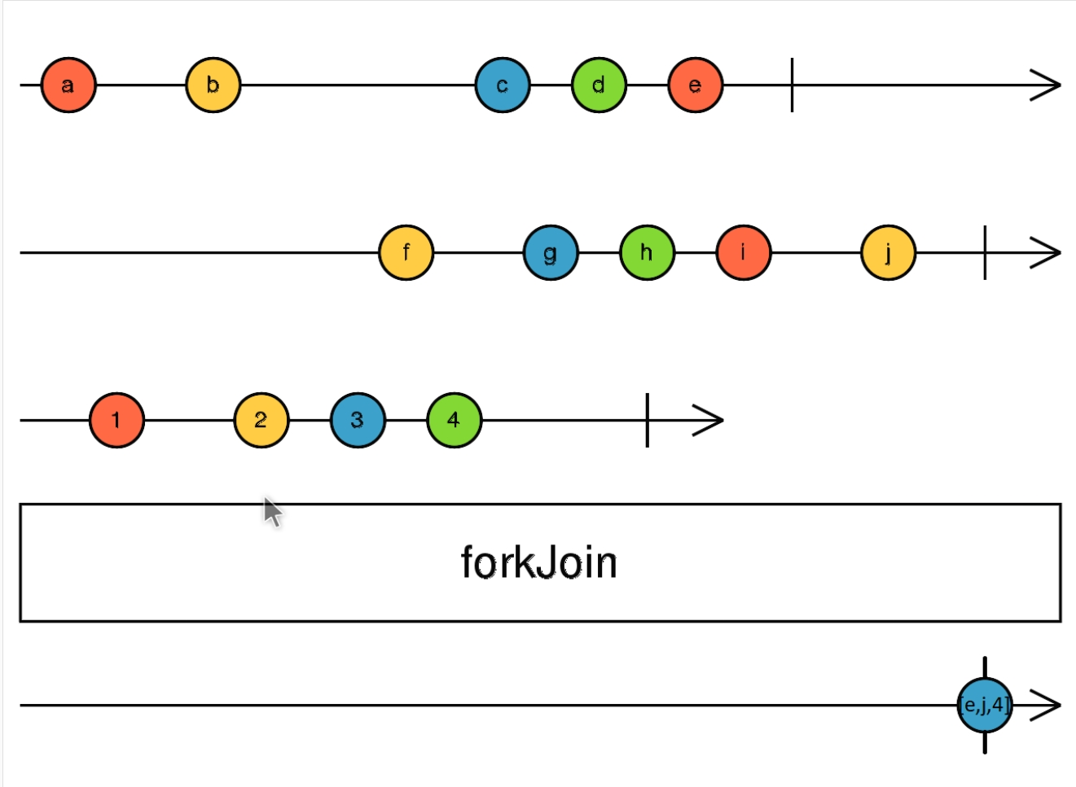
Creational Operators
18

Slide 37
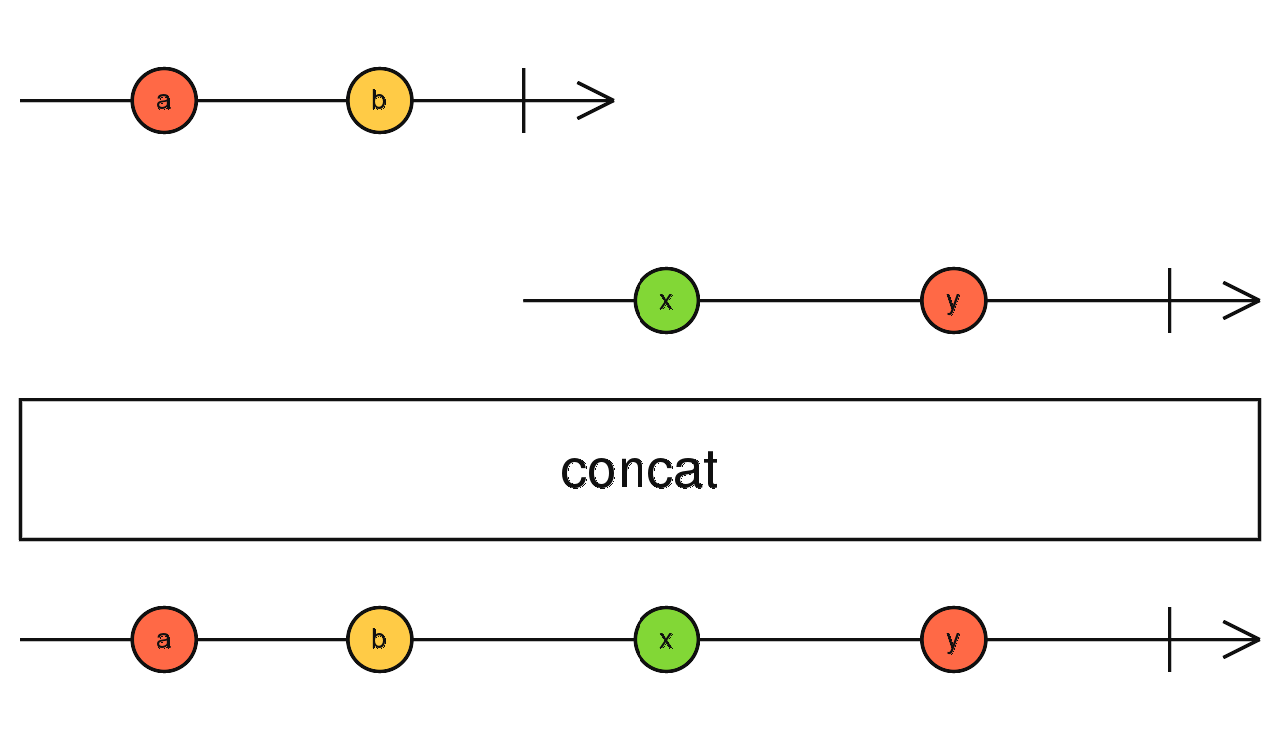
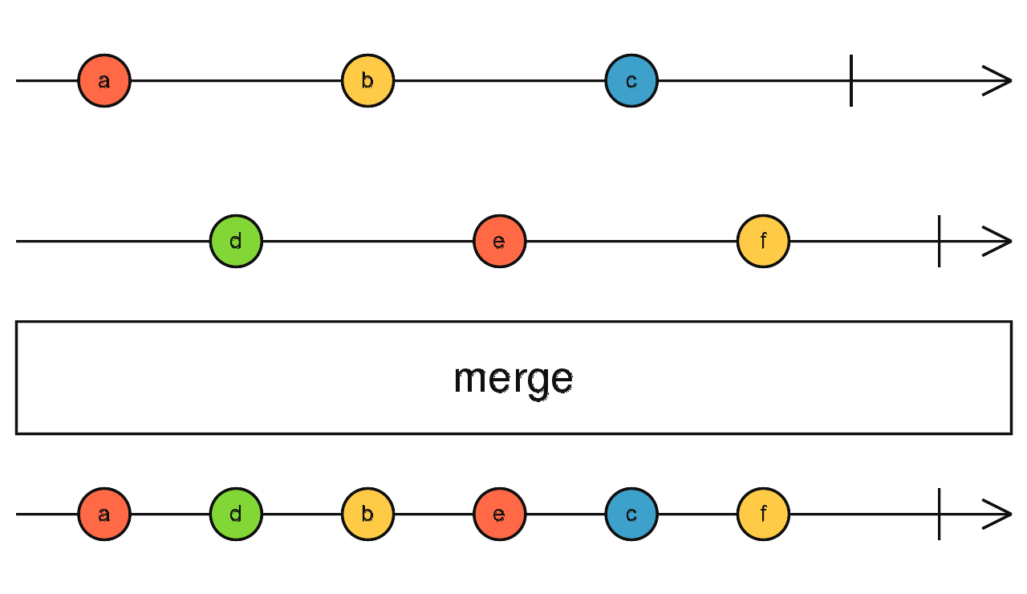
Creational Operators
19

Slide 38
Pipeable Operators
Consumer 1
Observable , of, timer, interval
Observable
Consumer 2
Consumer 3
20

Slide 39
Pipeable Operators
Pipe
Observable
(Transformed Data)
Observable (Data)
Consumer 1
Map (To Change Value)
Consumer 2
Consumer 3
21

Slide 40
Pipeable Operators
Pipe Composing
Observable
(Transformed Data)
Observable (Data)
Consumer 1
Map Filter
Consumer 2
Consumer 3
22

Slide 41
Pipeable Operators
Consumer 1
Observable
Consumer 2
Consumer 3
Pipe
Observable
(Transformed Data)
Observable (Data)
Consumer 1
Map (To Change Value)
Consumer 2
Consumer 3
Pipe Composing
Observable
(Transformed Data)
Observable (Data)
Consumer 1
Map Filter
Consumer 2
Consumer 3
23

Slide 42
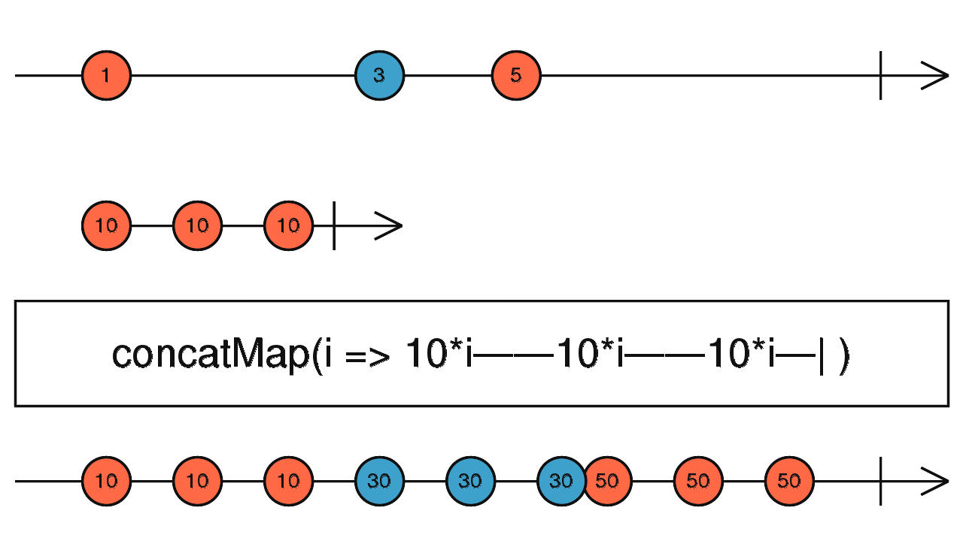
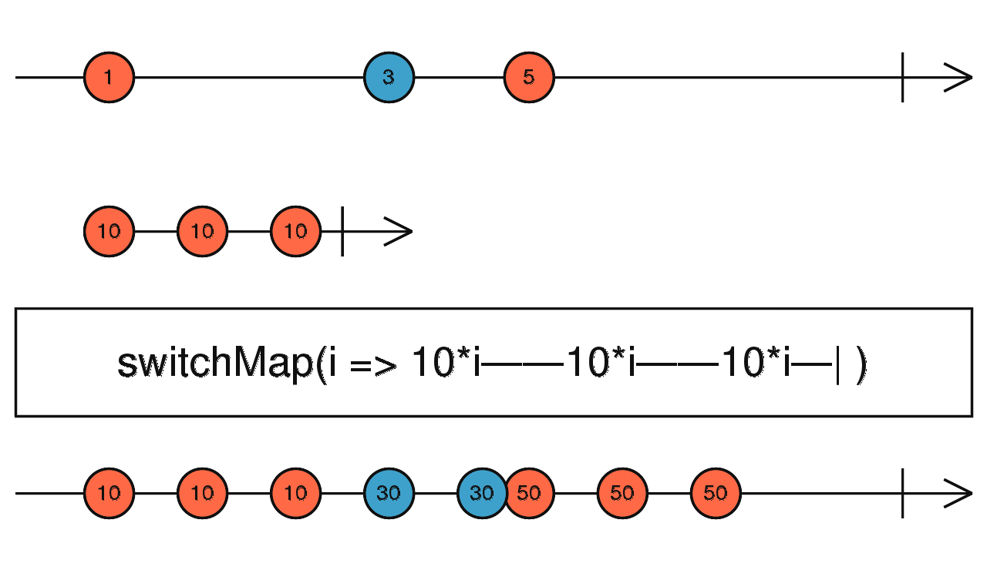
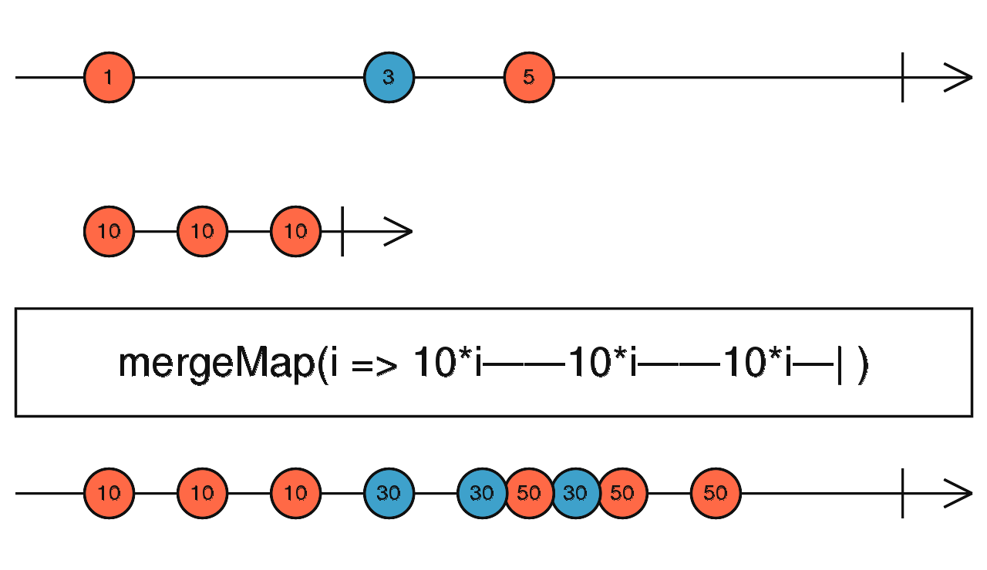
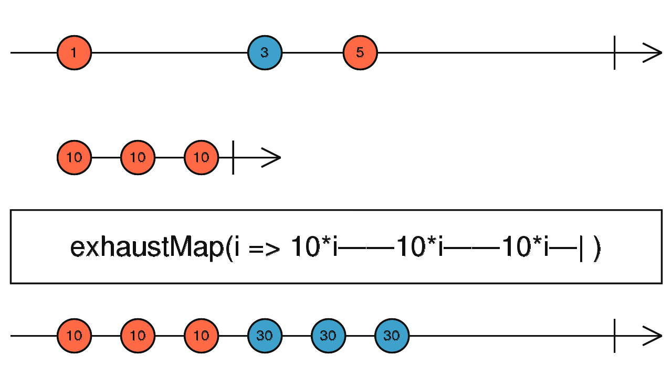
Higher Order Observables
24

Slide 43
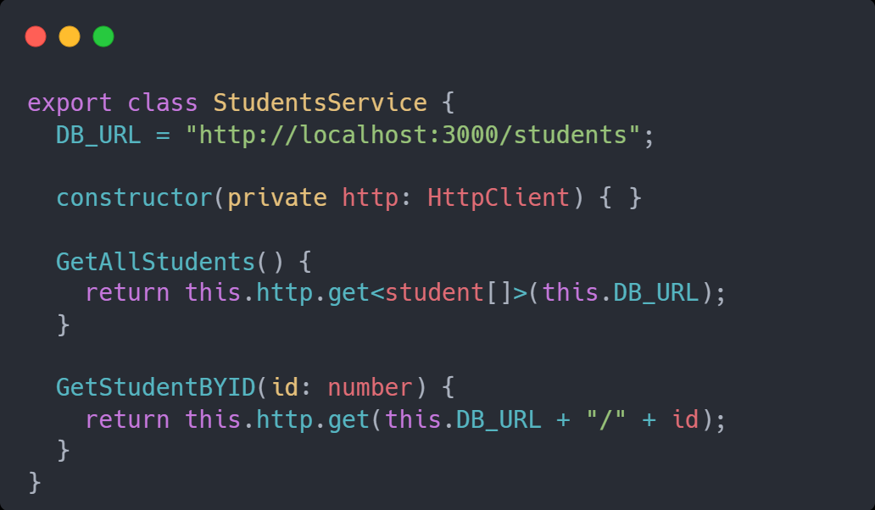
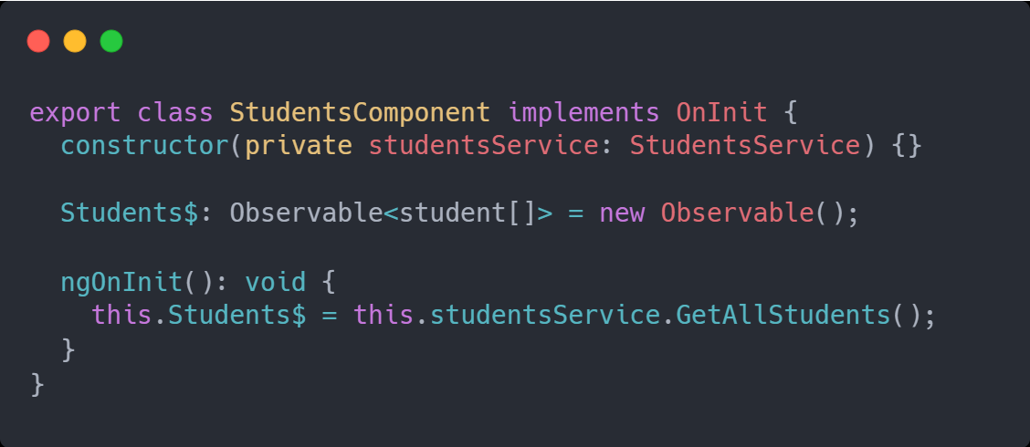
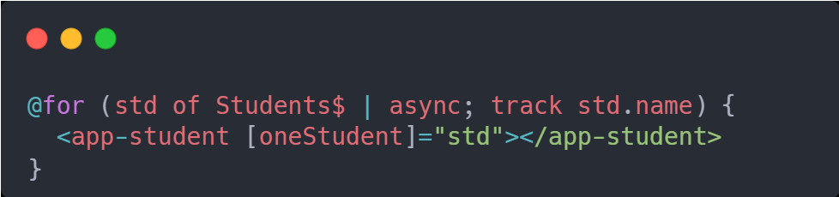
Async PIPE
Service
TS
HTML
26

Slide 44
NGRX
27

Slide 45
NGRX
Component
Component
Angular Redux
State Management
Data
Component
Component
?
?
?
?
Store
Reducer
State
Action
28

Slide 46
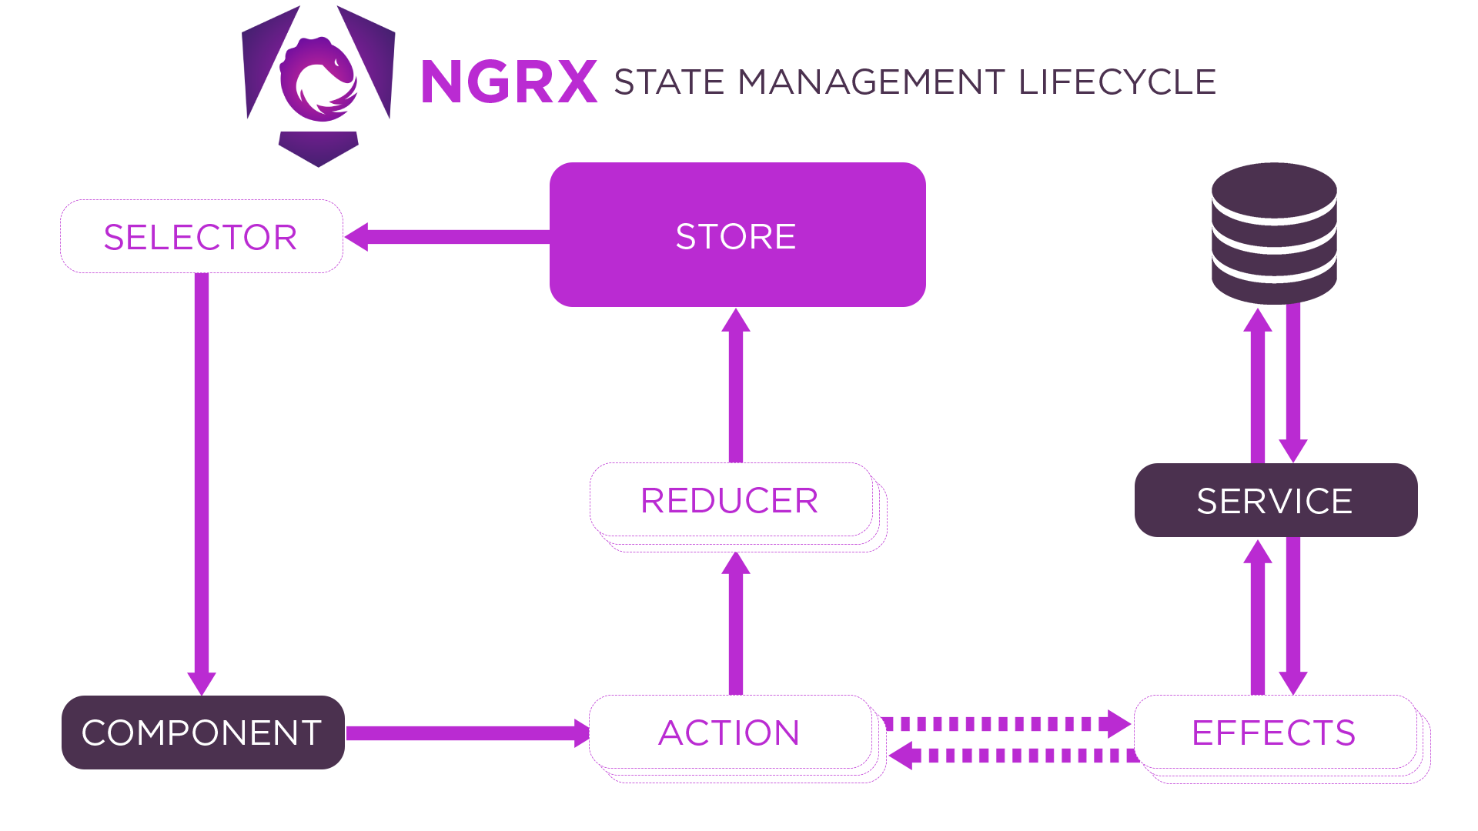
NGRX
--save
Means to add this package at dependencies
npm i --save @ngrx/store
npm i --save @ngrx/effects
29

Slide 47




NGRX
Store
Component
Action
State
Reducers
Order
{
Type: “ “,
Payload:.
}
------------------------
30

Slide 48
Store [Data]
State Reducers
change
Receive New Data
Action
Component
Component
Component
Component
31

Slide 49
AppComponent
Component 1
0
Component 2
+
-
32

Slide 50
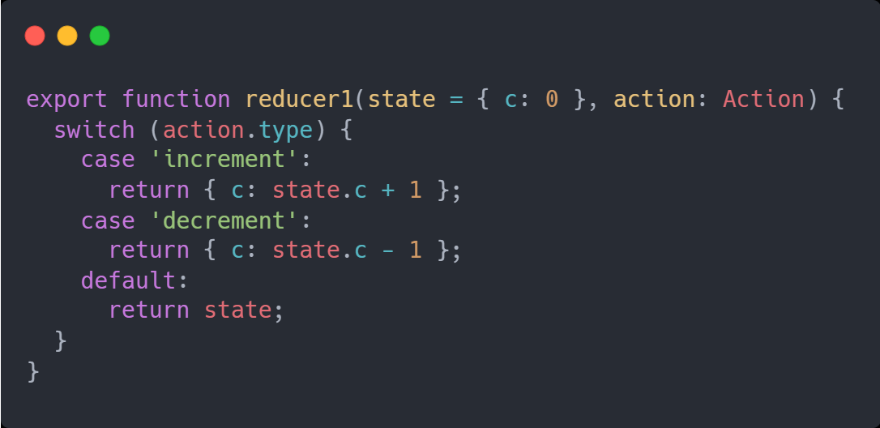
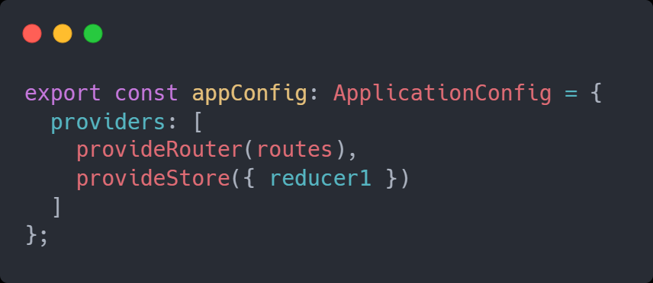
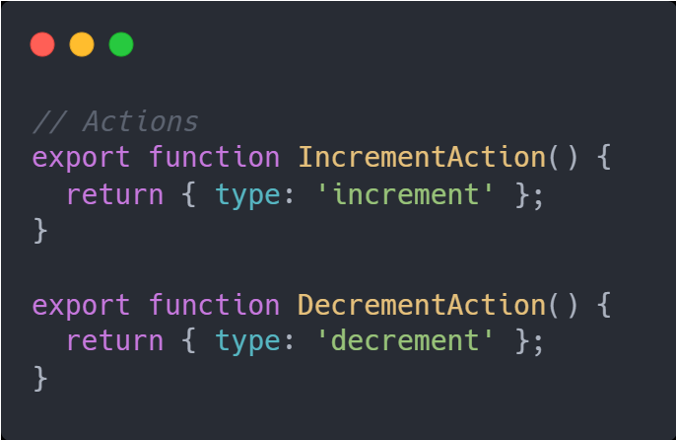
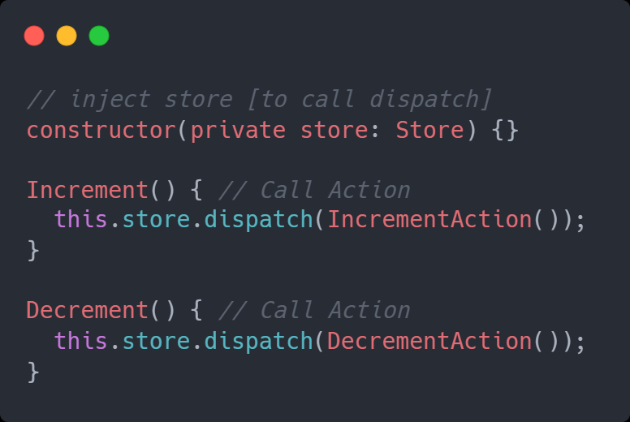
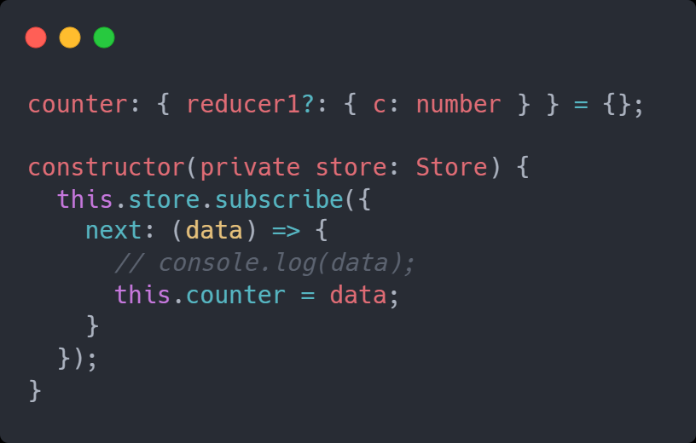
Store
app.config.ts
Actions
Component (Sender)
Component (Consumer)
33

Slide 51
NGRX [ SELECTORS ]
Use Part of state at Consumer Component
State = {c:0, username:’ ‘ }
Consumer Component
Counter:number = 0;
Constructor(store:Store){
this.store.select(CounterSelector).subscribe({
next:(data)=>{
this.counter = data;
}
})
}
Selector.ts
Let reducer1Sel = CreateFeatureSelector<>(‘reducer1’)
export let CounterSelector = CreateSelector(reducer1Sel)
34

Slide 52
AppComponent
1- Start To Call API
2- Success
3- Fail
Component 1
Name | Email | Phone
35

Slide 53

Thank You
mahmoudabdelazizibrahim11@gmail.com

